Slide 1

CLASSIFICATION OF SIGNIFICANT WATER RESOURCES AND DETERMINATION OF RESOURCE QUALITY OBJECTIVES IN THE USUTU TO MHLATHUZE CATCHMENT (WP11387)
BACKGROUND
Presentation by:
Koleka Makanda
PROJECT STEERING COMMITTEE MEETING 4: 13 APRIL 2023

Slide 2
PURPOSE
To provide background to the study
To provide progress to date on the study in the Usutu to Mhlathuze Catchment

Slide 3
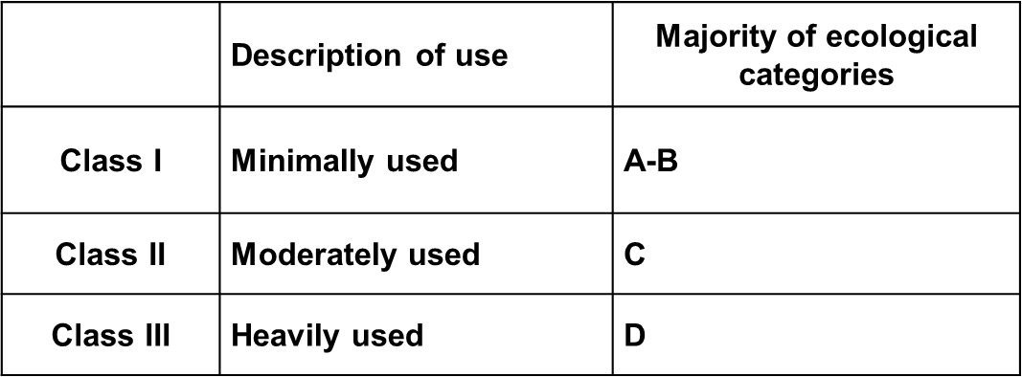
BACKGROUND
30 months project; from December 2021 to May 2024
Output:
  Water Resource Classes: describe what state the water resources need to be in to satisfy beneficial use.
  Resource Quality Objectives: conditions which should be met in the receiving water resource. Give effect to the implementation of the classes. RQOs provide statements about:
    - what the quantity of the water should be (water level, pattern, timing)
    - what the water quality should be (physical, chemical and biological
    - what the condition of the instream and riparian habitat should be
    - what the condition of the biota should be.

Slide 4
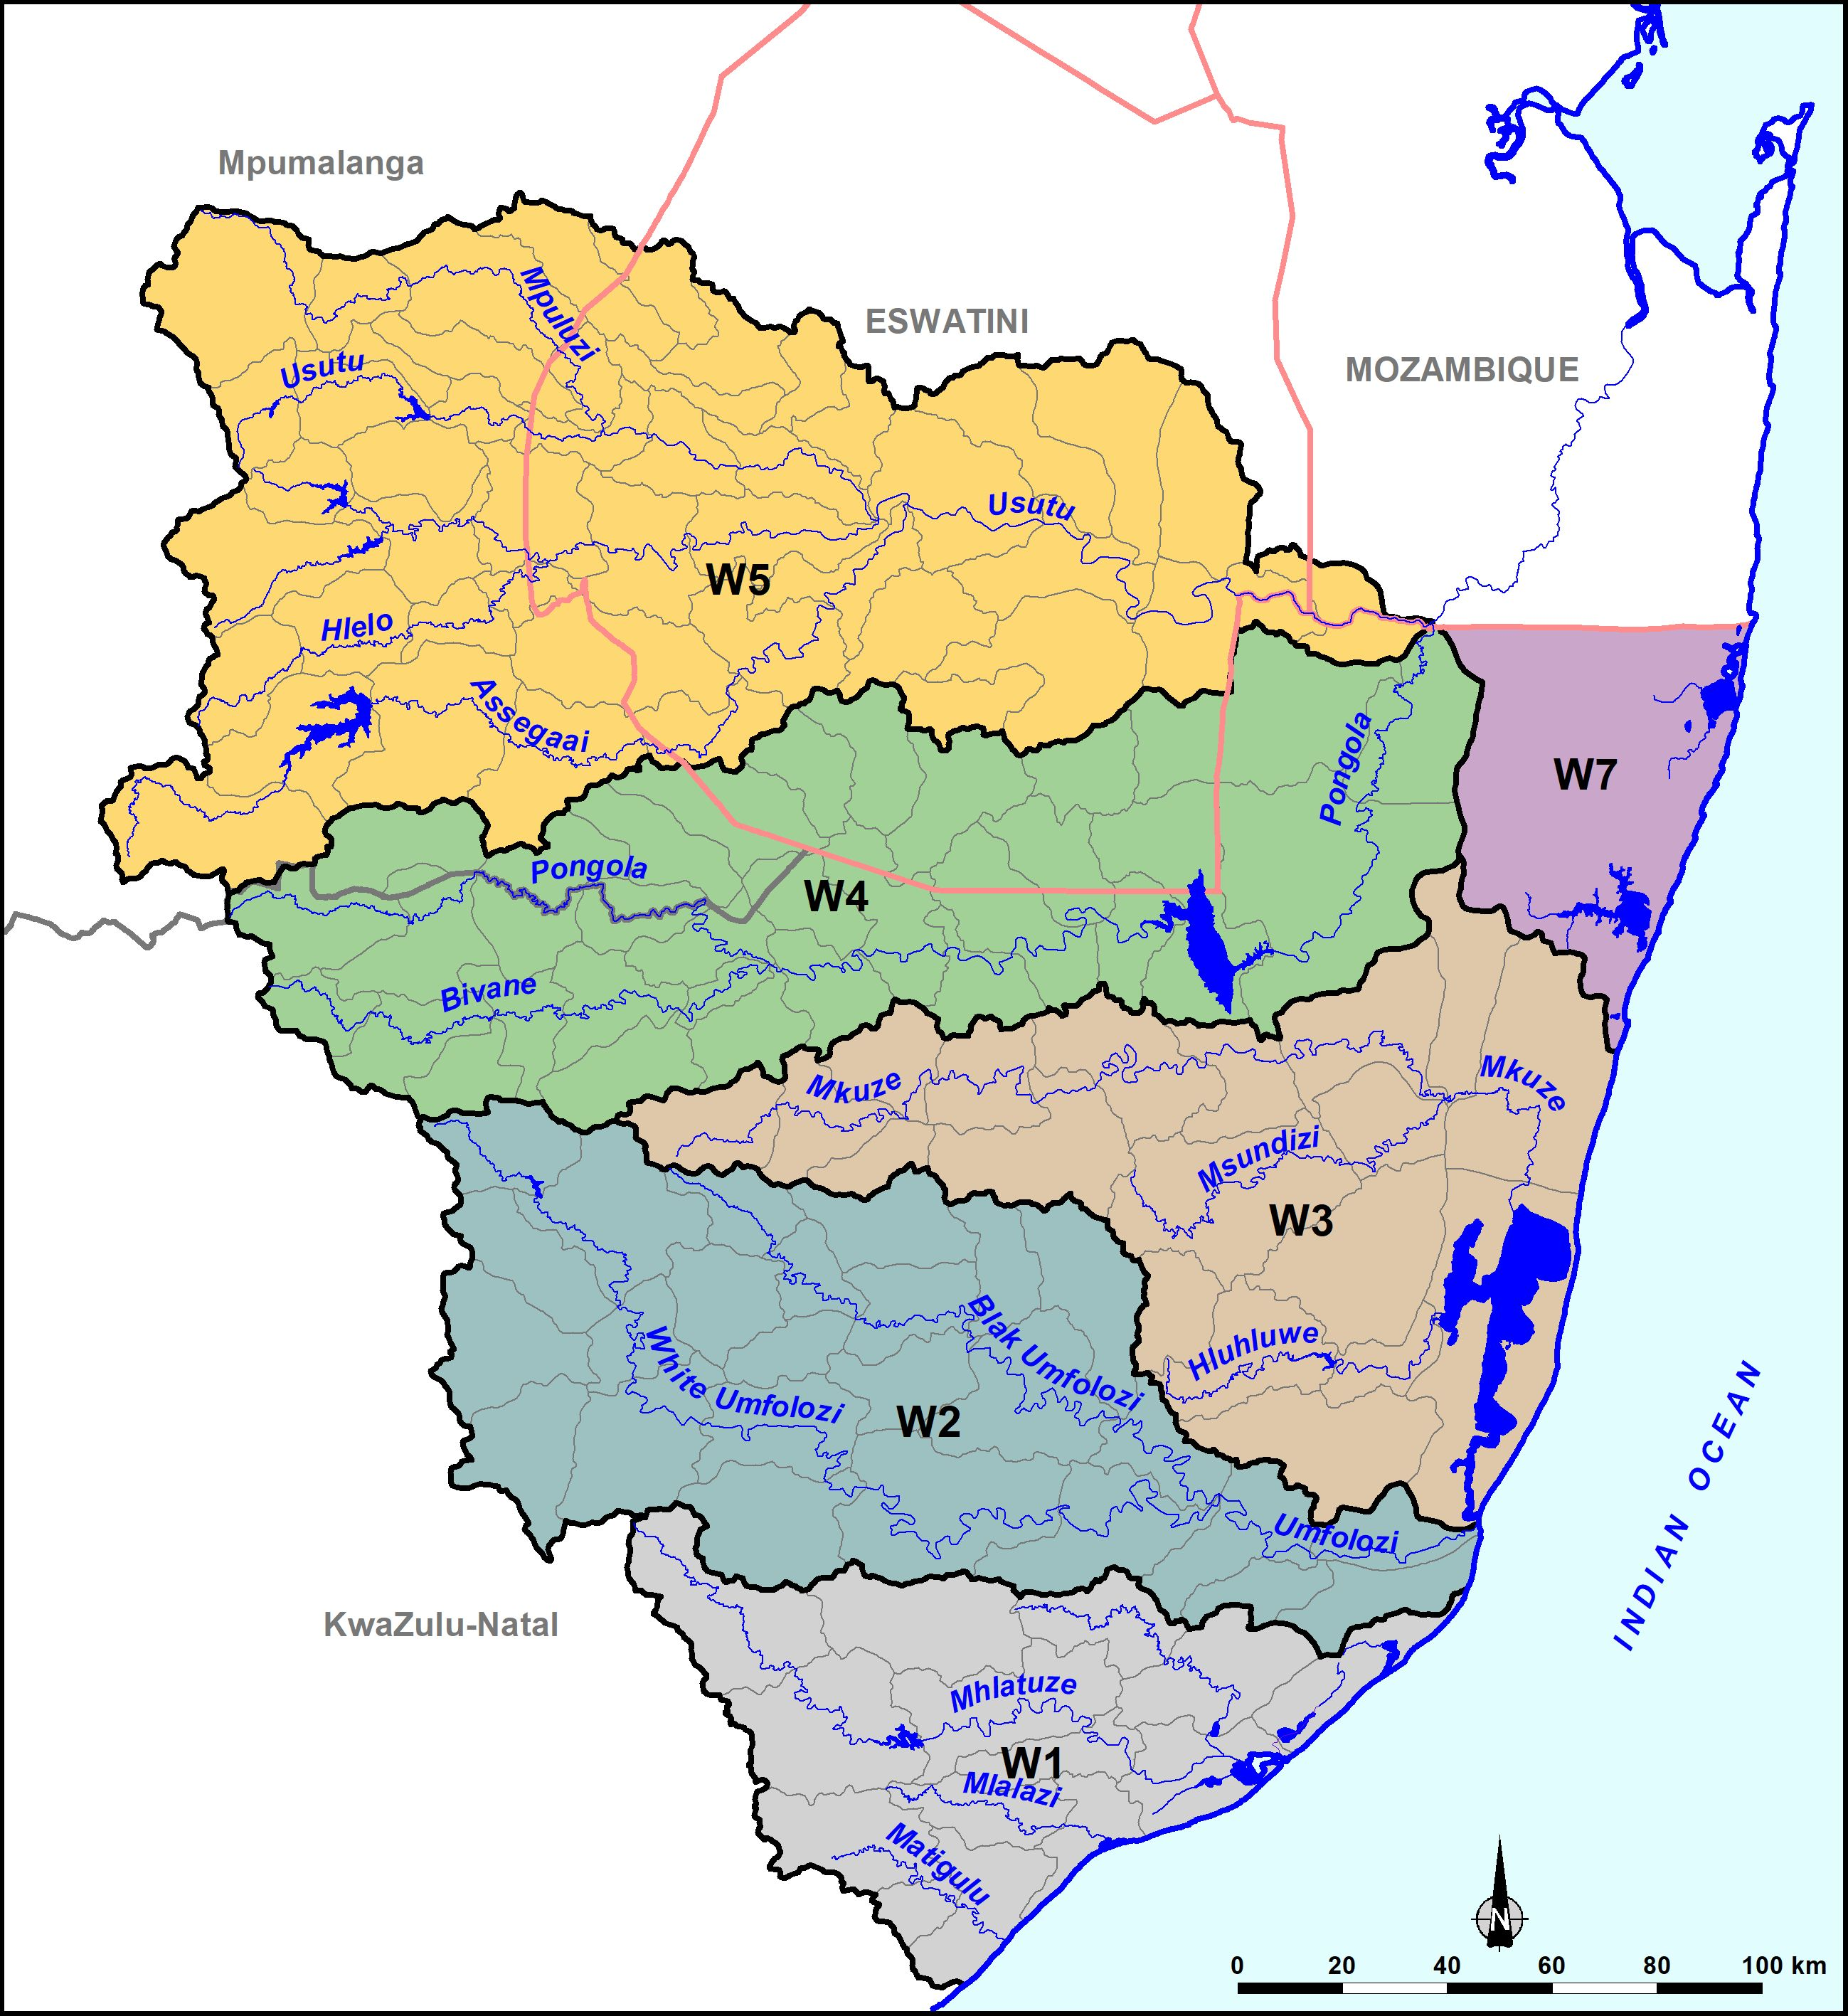
STUDY AREA
  Usutu - Mhlatuze Catchments
  Mhlatuze, W1
  Mfolozi, W2
  Mkuze/Hluhluwe, W3
  Pongola, W4
  Usutu, W5
  W7 catchment.

Slide 5
STUDY PROCESS & PROGRESS
1 | Delineate Integrated Units of Analysis (IUAs) and Resource Units (RUs) and describe the status quo | Completed | Stakeholder Engagement (In progress)
2 | Prioritise RUs and select study sites | Completed
3 | Quantify Basic Human Needs (BHN) and Ecological Water Requirements (EWRs) | Completed
4 | Identify and evaluate scenarios within the IWRM process | In progress
5 | Determine Water Resource Classes based on catchment configurations | In progress
6 | Determine RQOs and provide implementation information | Not yet started
7 | Gazette Water Resource Classes and RQOs | Not yet started

Slide 6
STAKEHOLDER ENGAGEMENT
Public Meeting: 04 May 2022
Purpose: Introduce the project
PSC 1: 07 June 2022
Purpose: Task 2 - IUA Delineation and Status Quo description
TTG 1: 03 Nov 2022
Purpose: Identification of water quality indicators for river RUs
PSC 2: 04 Nov 2022
Purpose: Task 3 – Quantification of EWRs and BHN
PSC 3: 02 Dec 2022
Purpose: Task 4 – Identification of scenarios
PSC 4 : 13 April 2023
Purpose: Task 4 – Present the consequences of operational scenarios within (IWRM) and Task 5 – Provide proposed Classes and catchment configuration for discussion

Slide 7
THANK YOU
Contacts:
 | Email address | Telephone | Mobile
Ms Koleka Makanda | makandac@dws.gov.za | 012 336 8406 | 066-514-2662
Ms Mohlapa Sekoele | sekoelem@dws.gov.za | 012 336 8329 | 082 809 5418
Ms Lebogang Matlala | matlalal@dws.gov.za | 012 336 6707 | 082 884 5399
http://www.dws.gov.za/rdm/WRCS/default.aspx

